Slide 1
Computer Organization and Assembly Language
(CS – 318)
3(2-1)
Fatima Naveed
Lecturer
The University of Faisalabad

Slide 2
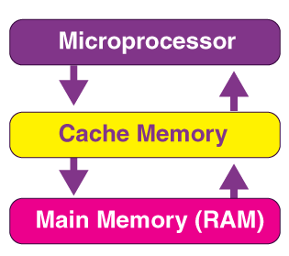
What is Cache Memory?
Cache memory refers to high-speed memory. It is small but faster than RAM (the main memory). The CPU can access the cache comparatively more quickly than its primary memory. Thus, we use it to synchronize with a high-speed CPU and also to improve its overall performance.

Slide 3
Accessing Cache Memory
Only the CPU can access the cache memory.
The cache holds the data and programs that the CPU uses frequently. Thus, it ensures that the information is instantaneously available for the CPU as and when the CPU needs this information.
In simpler words, if the CPU finds the required instructions or data in the system’s cache memory, it does NOT need to access its primary memory or RAM.

Slide 4

Structure of Cache Memory
Main memory consists of up to 2ˆn addressable words, with each word having a unique n-bit address.
For mapping purposes, this memory is considered to consist of a number of fixed length blocks of K words each.
That is, there are M = 2ˆn/K blocks in main memory.
The cache consists of m blocks, called lines.
Each line contains K words, plus a tag of a few bits.
Each line also includes control bits, such as a bit to indicate whether the line has been modified since being loaded into the cache.

Slide 5
Structure of Cache Memory
The length of a line, not including tag and control bits, is the line size.
The line size may be as small as 32 bits, with each “word” being a single byte; in this case the line size is 4 bytes.
The number of lines is considerably less than the number of main memory blocks (m<< M).
At any time, some subset of the blocks of memory resides in lines in the cache. If a word in a block of memory is read, that block is transferred to one of the lines of the cache. Because there are more blocks than lines, an individual line cannot be uniquely and permanently dedicated to a particular block.
Each line includes a tag that identifies which particular block is currently being stored.
The processor generates the read address (RA) of a word to be read. If the word is contained in the cache, it is delivered.

Slide 6
Types of Cache Memory
L1 Cache
This refers to the first level of any cache memory, usually known as the L1 cache or Level 1 cache.
In case the CPU consists of four cores (A quad-core CPU), each core will then have its own L1 cache.
The actual size of such a memory ranges from 2 kilobytes to 64 kilobytes.
The Level 1 cache has two further types of caches: The Instruction cache storing, the instructions that are required by a CPU, along with the data cache storing, the data that is required by a CPU.

Slide 7
Example:
A program executing on a processor needs to fetch the sequence of instructions (or code/program) from memory. At the same time the code/instruction might need to access data from different memory locations.
For e.g., lets say a program is reading one memory location and writing it into another location
Load reg0, memA
Store reg0, memB
There are two instructions (Load, Store) that needs to be fetched from instruction memory and the contents memA has to be read first and then written to memB
The instruction cache will prefetch and store all the instructions (in this case, load, store) into the instruction cache while the data cache will prefetch the memory locations accessed (like memA)
The benefits of having separate cache instead of a single cache is that both instruction fetch and decode can proceed separately from the load/store execution.

Slide 8
L2 Cache
The level 2 cache may reside both inside or outside any given CPU.
All the cores of the CPU can consist of their separate (own) level 2 cache, or they can even share a single L2 cache among themselves.
Now, in case it’s outside the CPU, it connects with the CPU using a very high-speed bus.
The memory size of a cache ranges from 256 kilobytes to 512 kilobytes.
If we go for the speed, these are comparatively slower than the Level 1 cache.

Slide 9
L3 Cache
This type of cache isn’t present in all of the processors. Only a few of the high-end processors may contain this type of cache.
We use the L3 cache to enhance the overall performance of the L1 and the L2 cache.
This type of memory is located outside a CPU.
The memory size of the L3 cache ranges from 1 to 8 megabytes.
Though the L3 cache is slower than that of the L1 cache and the L2 cache, it is much faster than that of the RAM

Slide 10
How does the Cache Memory work with the CPU?
Whenever a CPU needs the data/information, it first of all looks inside its L1 cache.
In case it doesn’t find anything in the L1 cache, then it looks inside L2.
If it again does not find any data in L2, it then looks into L3.
Now, if the information is found in the memory of the cache, then it is called a cache hit. On the other hand, if data isn’t found inside this cache, then it is known as a cache miss.

Slide 11
Cache Coherence
However, there is a creation of a problem known as a coherence problem. In a single CPU system, two copies of the same data, one in the cache memory and another one in main memory may become different due to which it can result in inconsistencies in the value of cache and main memory.
Techniques for cache coherence
Write through: In this technique write the data in the cache and in main memory, which will always keep the two copies of data consistent.
Write back: In this method, updates are made in the cache, by setting a bit called update bit. Only those blocks whose updates bit is set is replaced in the main memory.

Slide 12
Replacement algorithm of cache memory
When the cache is full, there is a need for replacement algorithm for replacing the cache block with a new block. In the cache memory, there are three types of replacement algorithm are used that are:
Random replacement policy.
First in first Out (FIFO) replacement policy
Least recently used (LCU) replacement policy.

Slide 13
Random replacement policy
This is a very simple algorithm which used to choose the block to be overwritten at random. In this algorithm replace any cache line by using random selection. It is an algorithm which is simple and has been found to be very effective in practice.
First in first out (FIFO)
In this algorithm replace the cache block which is having the longest time stamp.

Slide 14
Least recently used (LRU)
It defines the policy to discard the least recently used items first from the cache and make room for new elements when the cache is full. It is used to organize items in order of their use, which allows identifying items that have not been used for a long time.

Slide 15
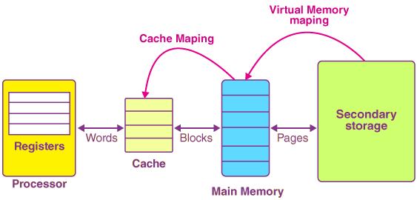
Process of Cache Mapping
The process of cache mapping helps us define how a certain block that is present in the main memory gets mapped to the memory of a cache in the case of any cache miss.

